Slide 1

NSG Pilkington – University of Liverpool Machine Learning Project: 23/09/2020
Dr. Peter Green
Diego Echeverria
Risk Institute,
School of Engineering

Slide 2
Training
Fault
Density
lag
Time
Tag 1
Time
Tag 2
Time

Slide 3
Training
Fault
Density
lag
To illustrate the approach, we assume that the model input is made up of all tags at the same time lag but in general this doesn’t have to be true.
Time
Tag 1
Time
Tag 2
Time

Slide 4
Predictions
Now
Fault
Density
lag
Time
Tag 1
Time
Tag 2
Time

Slide 5
Predictions
Now
Fault
Density
lag
Time
Tag 1
Time
Tag 2
Time

Slide 6
Predictions
Now
Fault
Density
lag
Time
Tag 1
Time
Tag 2
Time

Slide 7
Predictions
Now
Fault
Density
lag
Time
Tag 1
Time
Tag 2
Time

Slide 8
Predictions
Now
Fault
Density
lag
Time
Tag 1
Time
Tag 2
Time

Slide 9
Predictions
Now
Fault
Density
lag
Time
Tag 1
Time
Tag 2
Time

Slide 10
Predictions
Now
Model updated with new
fault density measurement
Fault
Density
lag
Time
Tag 1
Time
Tag 2
Time

Slide 11
Predictions
Now
Fault
Density
lag
Predictions updated
Time
Tag 1
Time
Tag 2
Time

Slide 12
Predictions
Now
Fault
Density
lag
Predictions updated
Time
Tag 1
Time
Tag 2
Time

Slide 13
Predictions
Now
Fault
Density
lag
Predictions updated
Time
Tag 1
Time
Tag 2
Time

Slide 14
Predictions
Now
Fault
Density
lag
Predictions updated
Time
Tag 1
Time
Tag 2
Time

Slide 15
Predictions
Now
Fault
Density
lag
New prediction
Time
Tag 1
Time
Tag 2
Time

Slide 16
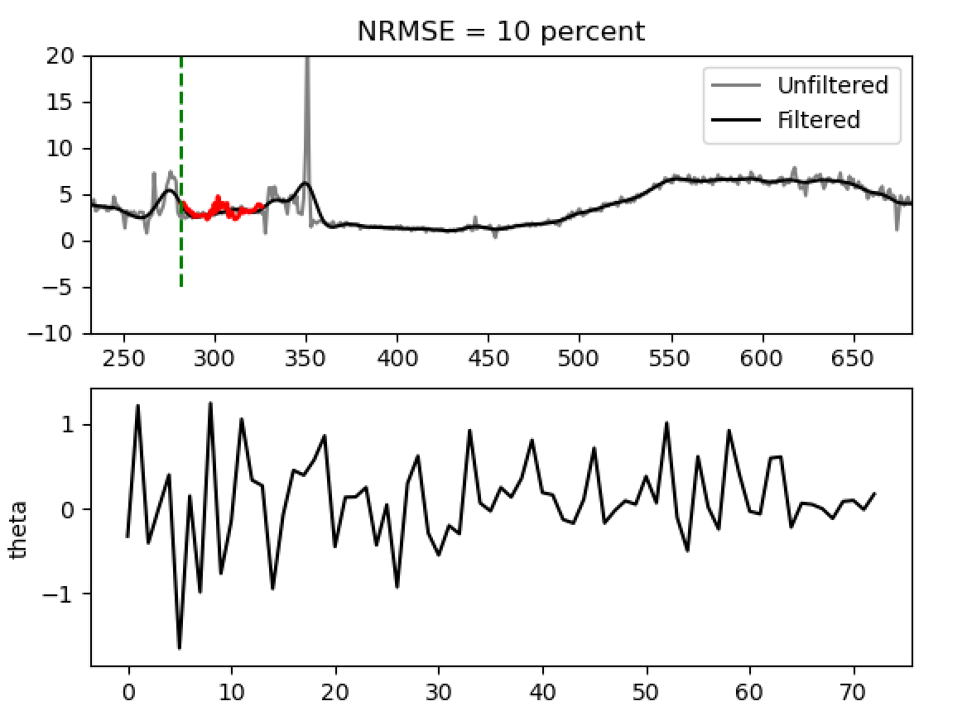
Example Results

Slide 17
Example Results
Future predictions (15 hours for now)
NRMSE over the current predictions
Model parameters; updated online as the model runs
Both filtered and unfiltered furnace faults are shown

Slide 18
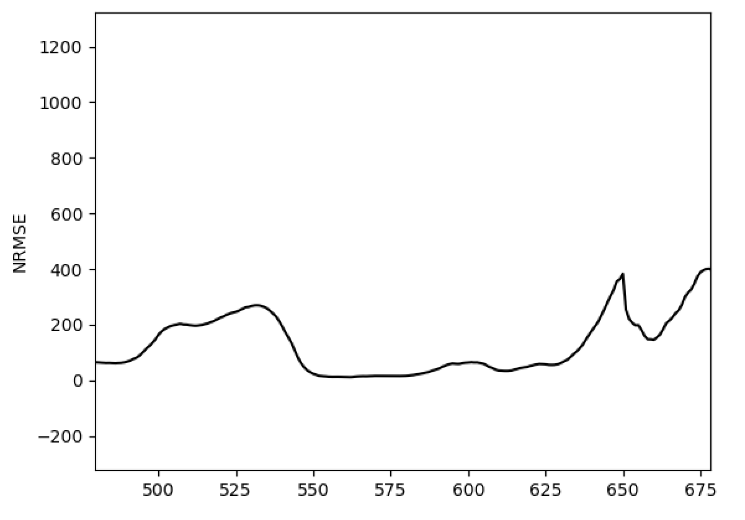
Example Results
Key next steps:
New error metric (average predictive NRME?)
Varied time lags per input
Including thickness and load
Nonlinear regression model
Regardless, it is worth considering what is causing large spikes in model performance.
A closer look at the input data?

Slide 19
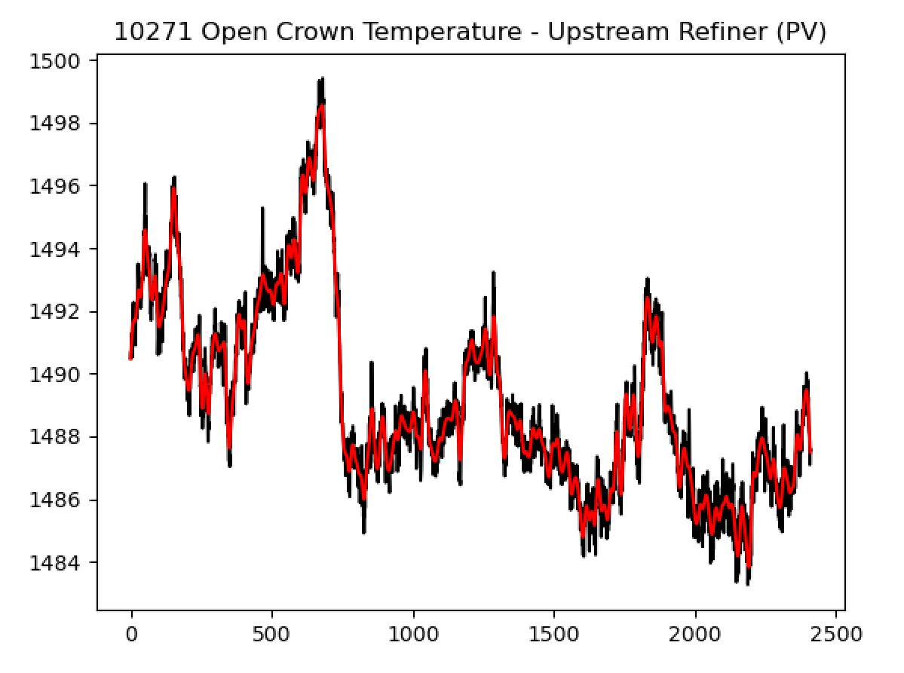
Closer look at input data
First, we note that we’re putting many of these signals through low-pass filters (example shown here).

Slide 20
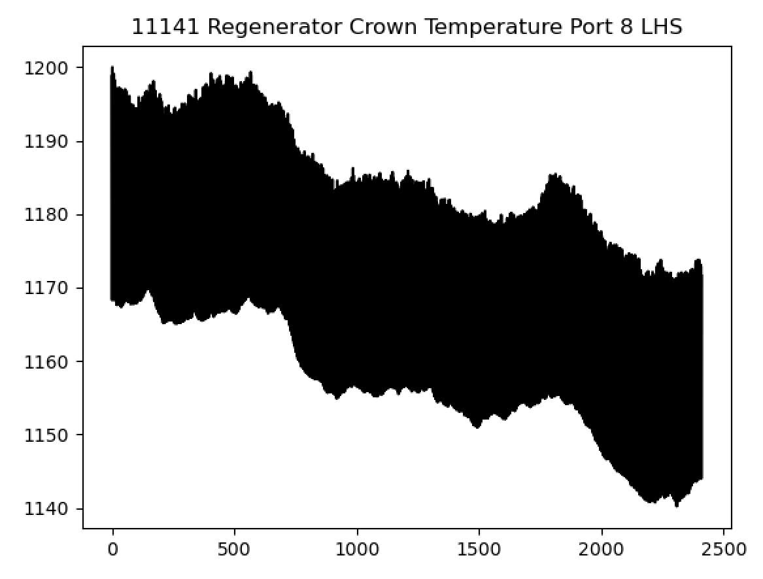
Closer look at input data
But there are others that show a low frequency drift.
Is this real?
Should we pass these through a high-pass filter to remove the drift?
Could be hurting the model’s “long range” performance.

Slide 21
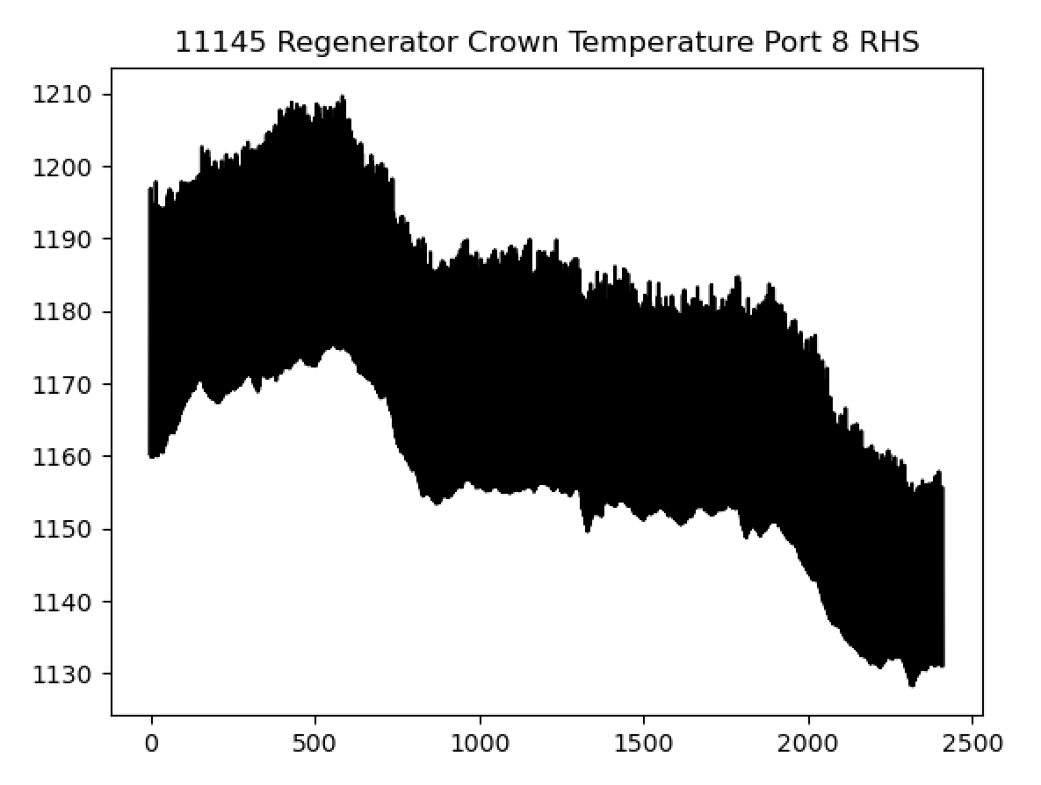
Closer look at input data
But there are others that show a low frequency drift.
Is this real?
Should we pass these through a high-pass filter to remove the drift?
Could be hurting the model’s “long range” performance.

Slide 22
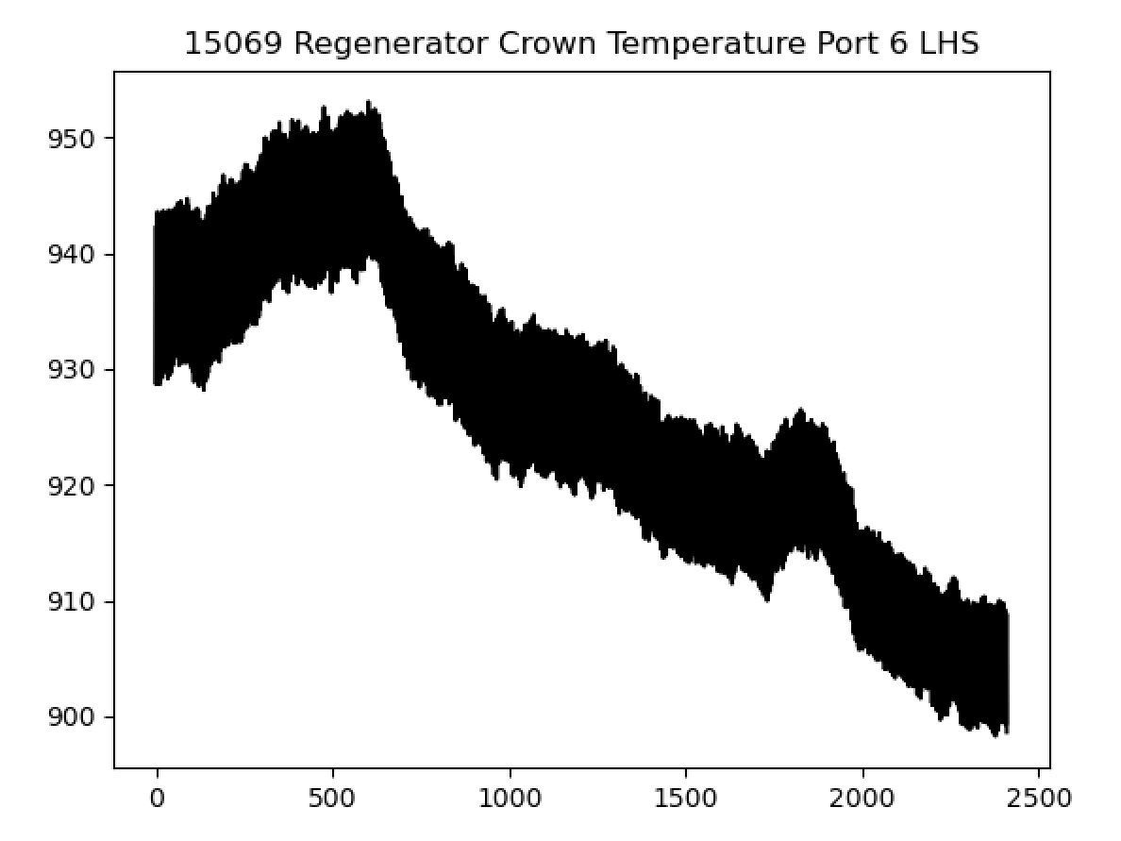
Closer look at input data
But there are others that show a low frequency drift.
Is this real?
Should we pass these through a high-pass filter to remove the drift?
Could be hurting the model’s “long range” performance.

Slide 23
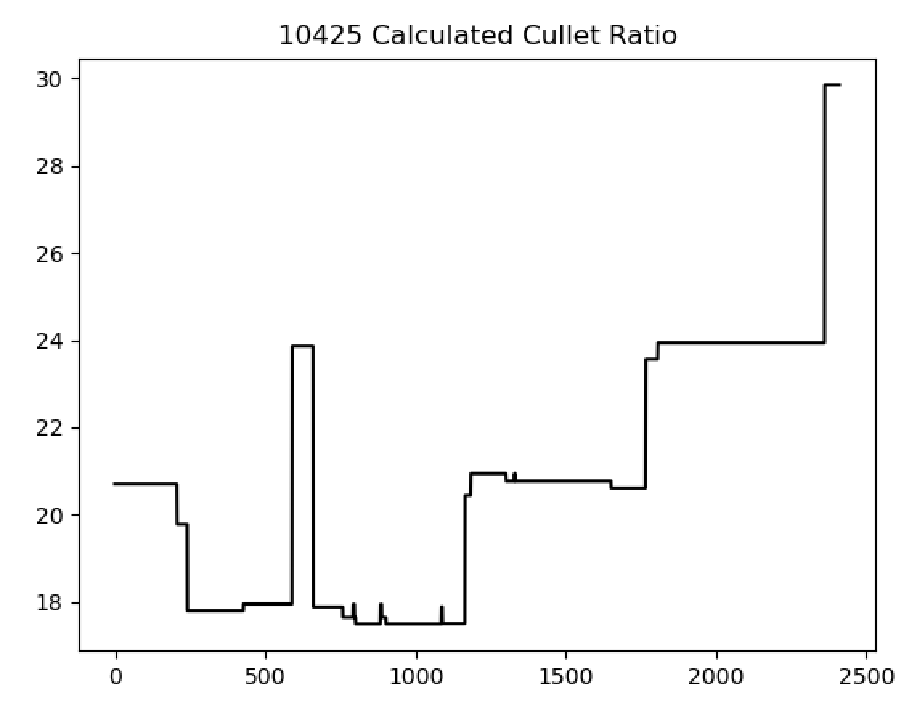
Closer look at input data
We also have 23 sets of input data that have very sudden changes / look like they have come from a low resolution sensor.
Example of sudden changes:
(Again, should we filter?)

Slide 24
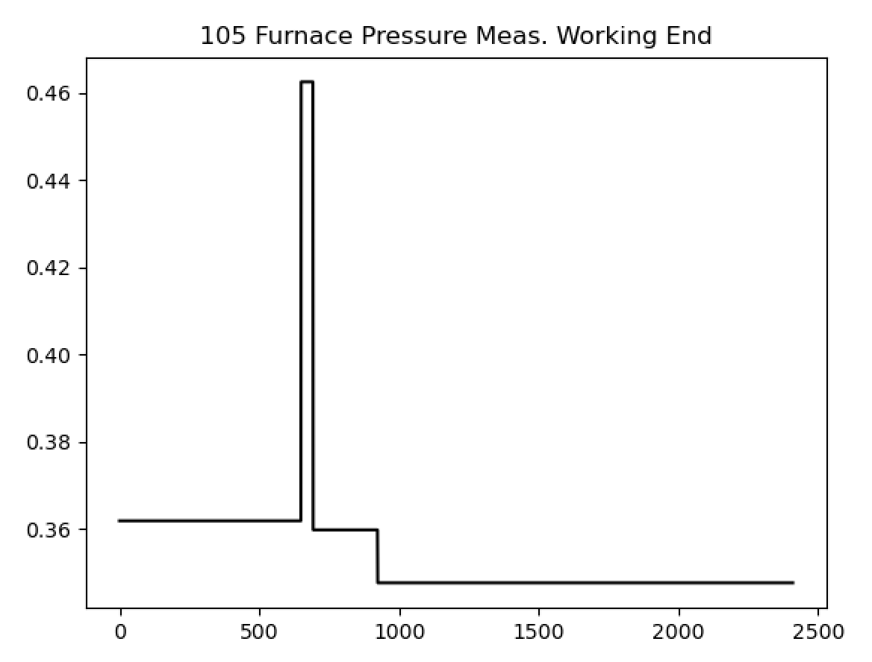
Closer look at input data
We also have 23 sets of input data that have very sudden changes / look like they have come from a low resolution sensor.
Example of sudden changes:
(Again, should we filter?)

Slide 25
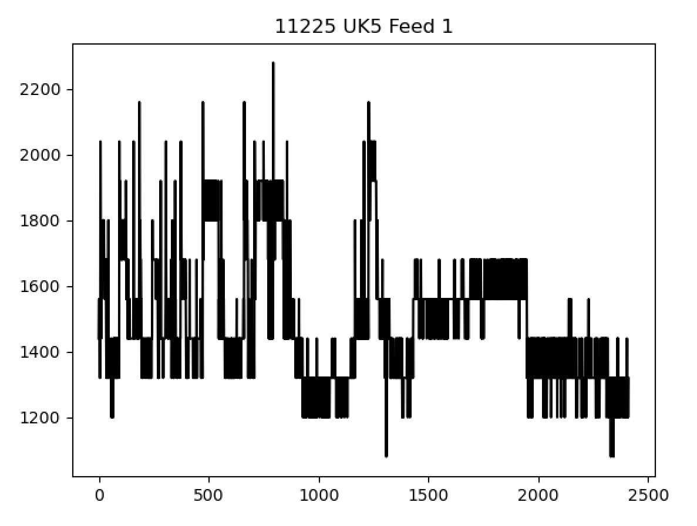
Closer look at input data
We also have 23 sets of input data that have very sudden changes / look like they have come from a low resolution sensor.
Example of low resolution signal:

Slide 26
Closer look at input data
The 23 sets that show this sort of behaviour:
10425 Calculated Cullet Ratio
105 Furnace Pressure Meas. Working End
11111 Port 2 - 3 Combustion Air Flow LHS (OP)
11123 Port 6 - 7 Combustion Air Flow LHS (OP)
11126 Port 6 - 7 Combustion Air Flow RHS (OP))
11129 Port 8 Combustion Air Flow LHS (OP)
11174 Furnace Bottom Temperature 18m D/S of B8
11209 MV49
11217 Services Building MCC9 Cat \'B\' Supply - MV60
11225 UK5 Feed 1
11226 UK6 Total Load
11299 UK6 Feed 1
11300 UK6 Feed 2
30060 U/S Flowing End Air Flow Measurement
30208 Feeder Speed Measurement Left
30209 Feeder Speed Measurement Right
7474 Lehr Drive Line Shaft Speed
9282 Tweel Position
9395 Main Gas Pressure (OP)
9397 Port 3 Gas Flow (OP)
9399 Port 2 Gas Flow (OP)
9461 Port 6 Gas Flow (OP)
9579 Port 5 Gas Flow (OP)

Slide 27
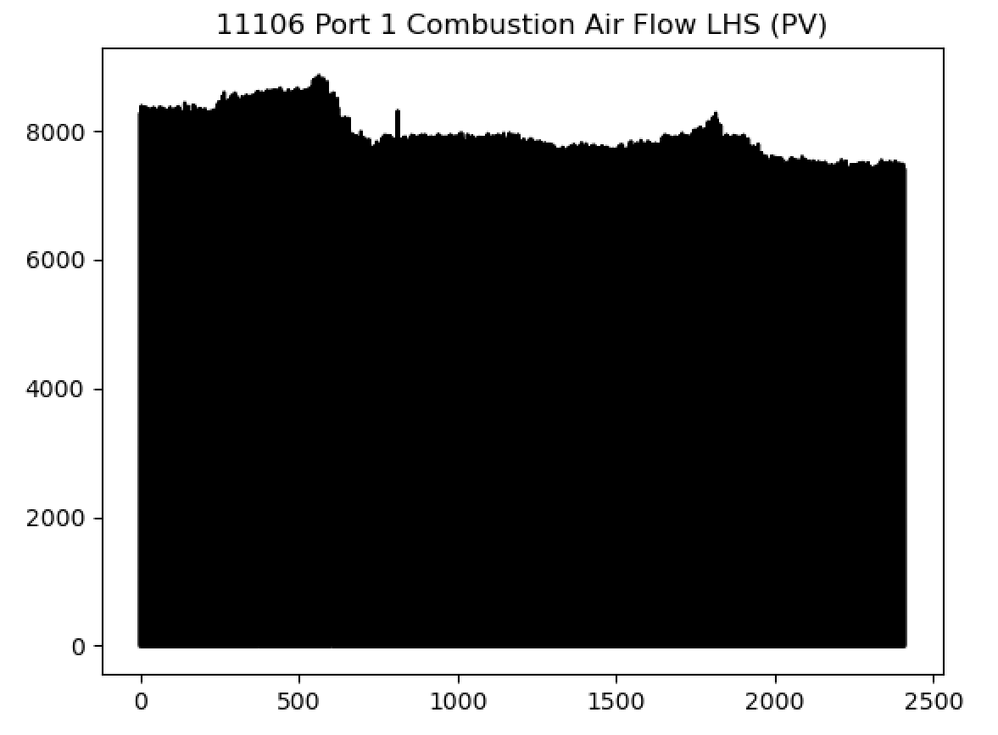
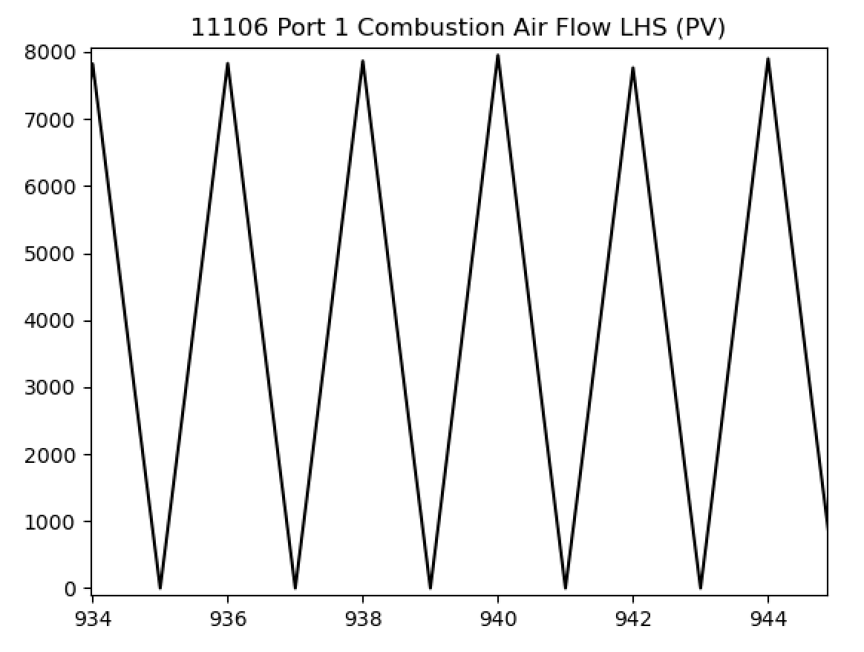
Closer look at input data
And there are some that just look a bit strange?

Slide 28
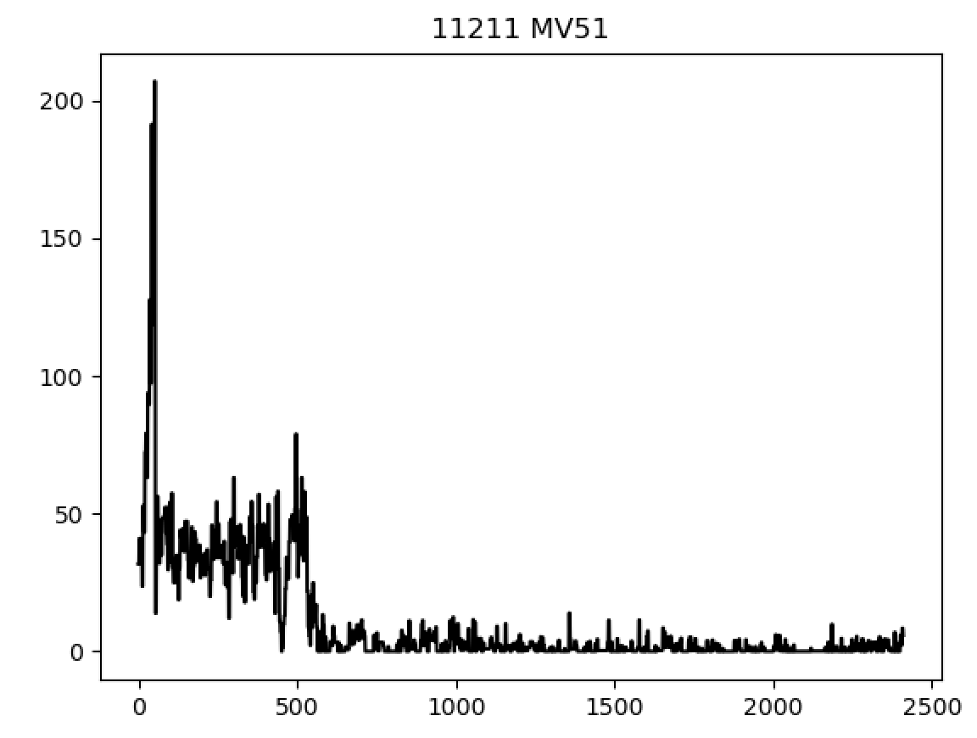
Closer look at input data
And there are some that just look a bit strange?

Slide 29
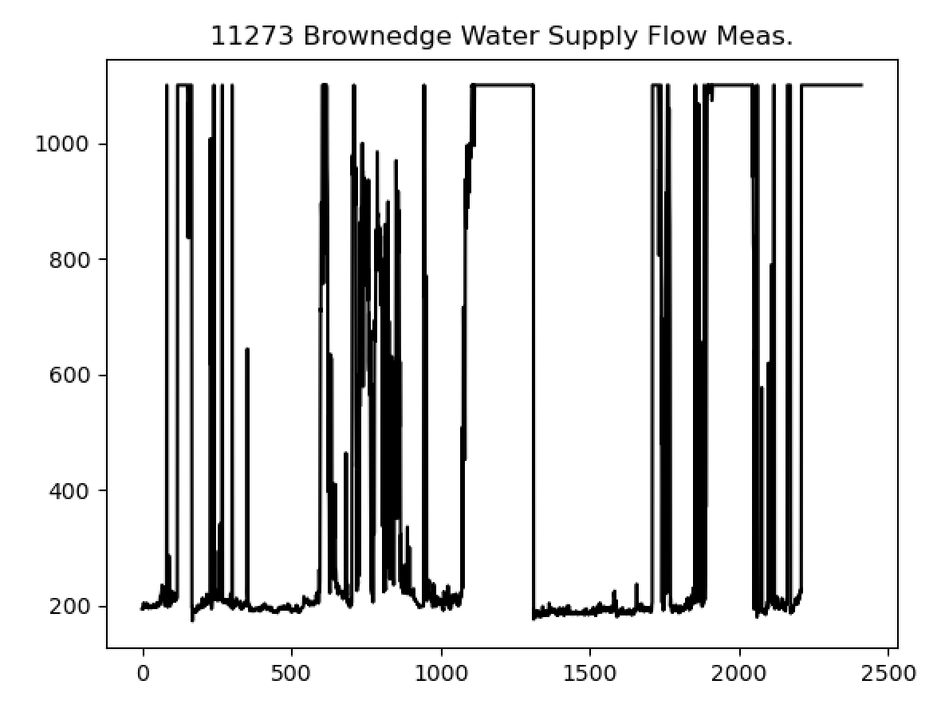
Closer look at input data
And there are some that just look a bit strange?
Signal saturation?

Slide 30
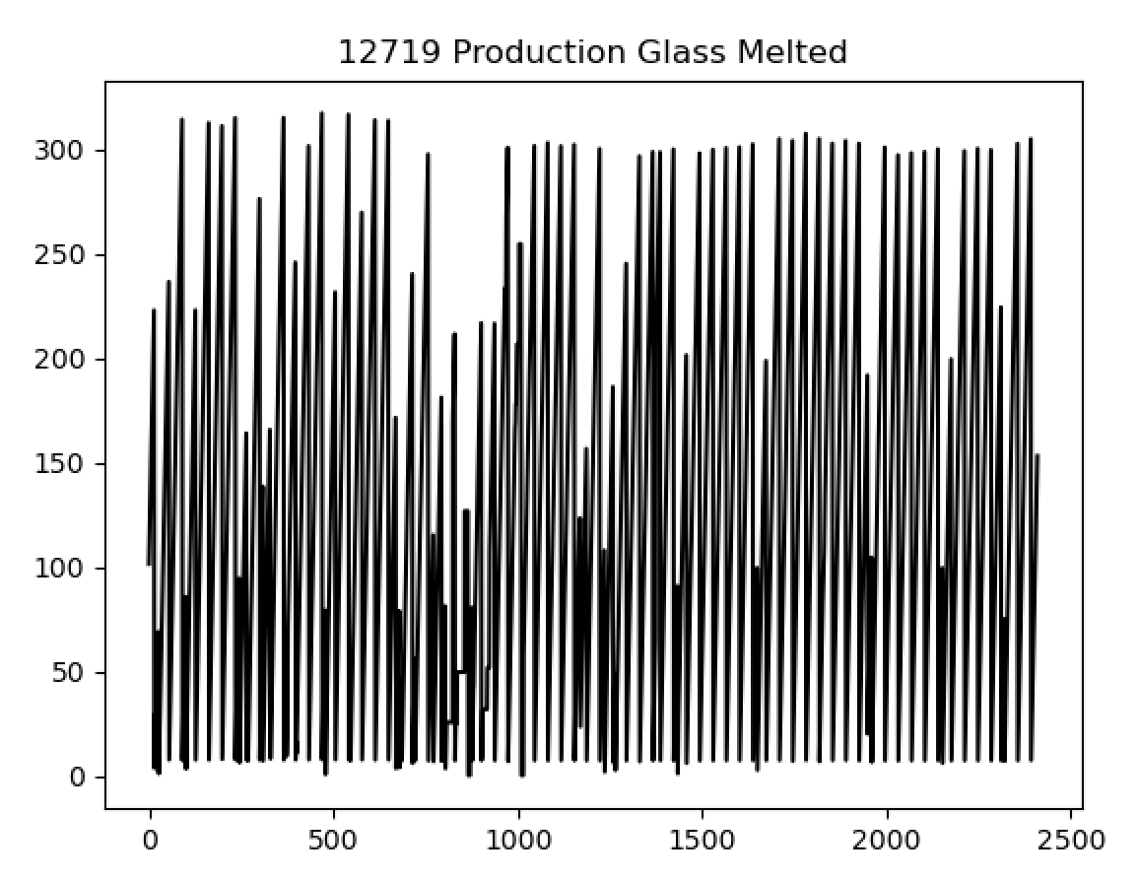
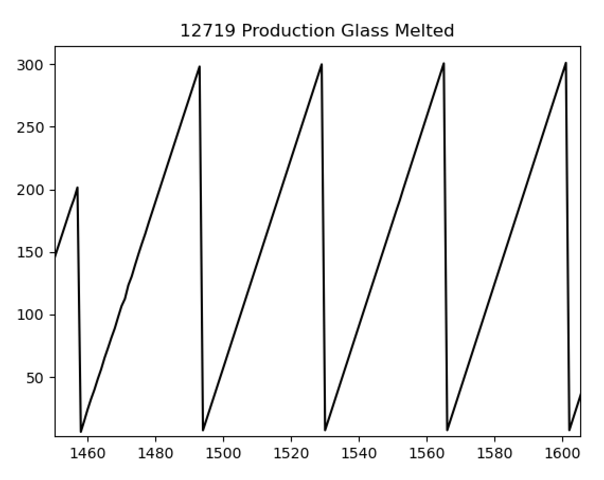
Closer look at input data
And there are some that just look a bit strange?

Slide 31
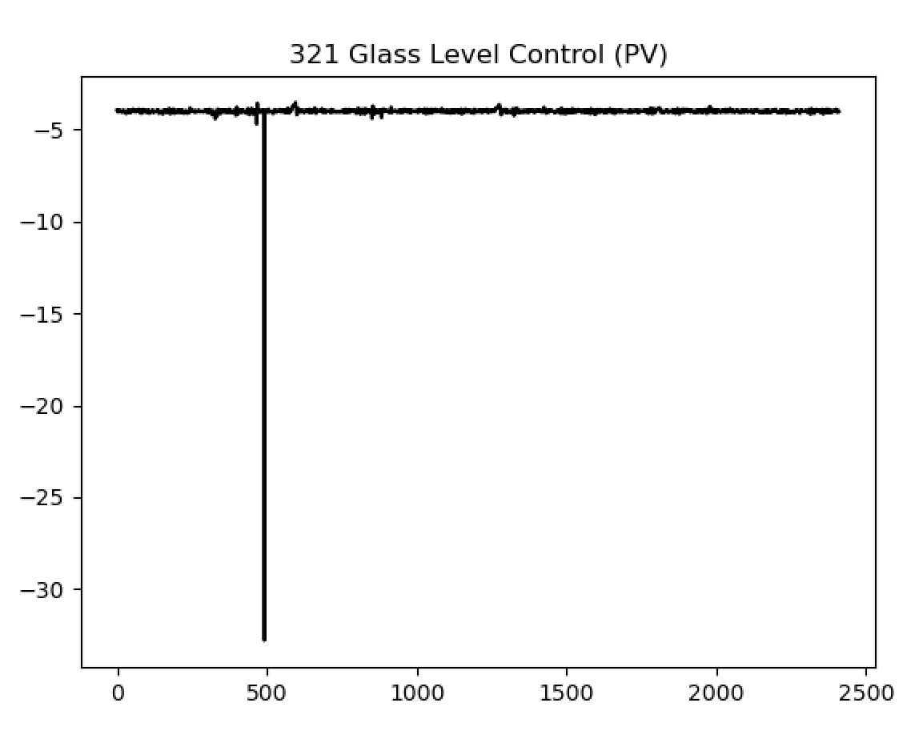
Closer look at input data
And there are some that just look a bit strange?

Slide 32
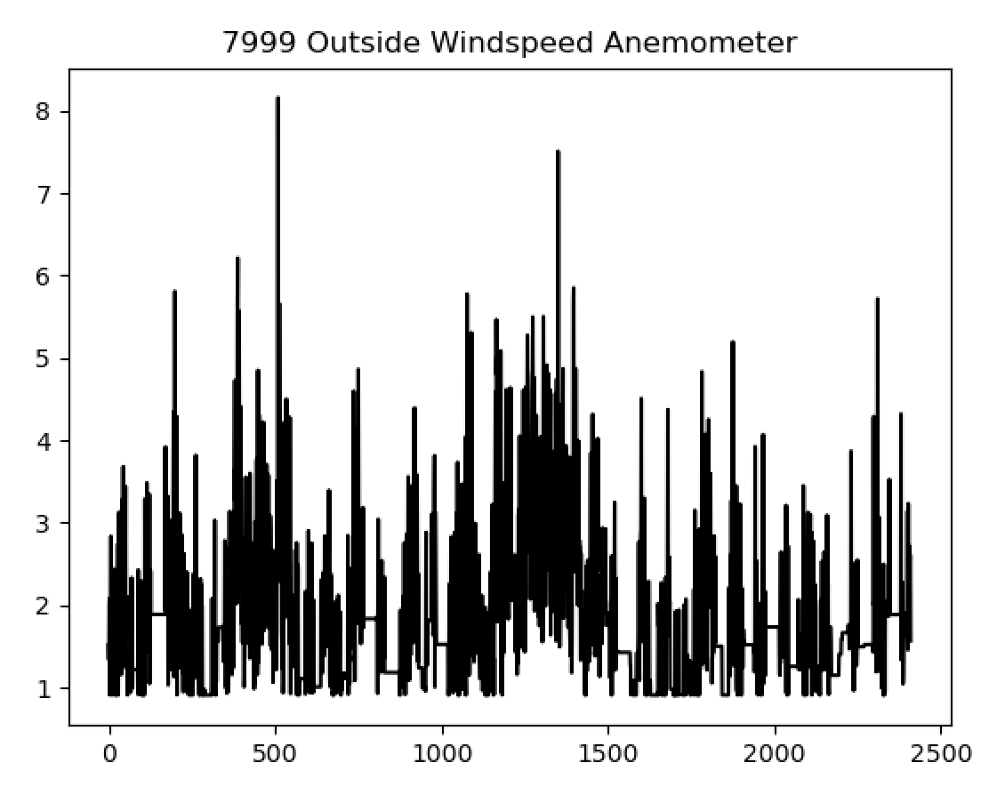
Closer look at input data
And there are some that just look a bit strange?
Was just curious how this might be important?

Slide 33
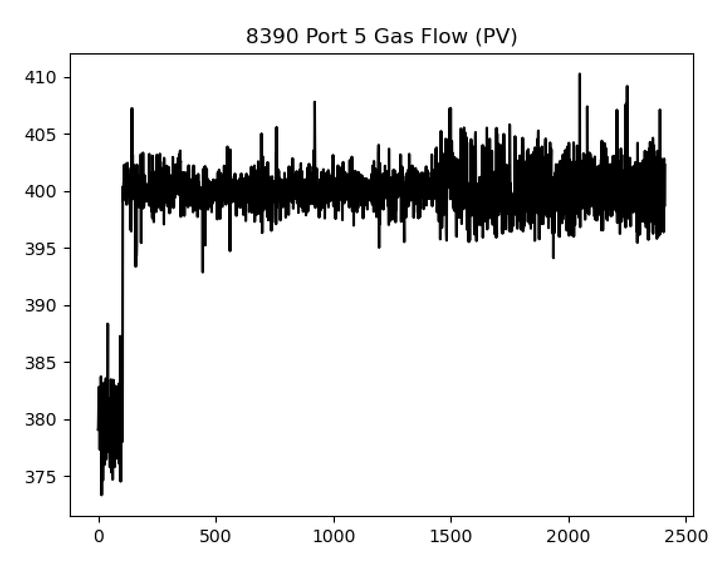
Closer look at input data
And there are some that just look a bit strange?

Slide 34
Summary
Now using the 76 tags that were specifically chosen by the team. Will use these as model inputs from now on.
Established model framework for online future predictions of glass quality.
Next steps (near-term):
Will need to use a new error metric for the model (average prediction NRMSE when the model is run over the full dataset).
Include thickness and load as inputs.
Separate time lags for each input type is a crucial next step.
Will need to investigate using a nonlinear model structure (and how to communicate its outputs; we have a plan for this).
Next steps (longer-term):
We (Liverpool) need to develop our understanding of the input data.
Specifically, need to decide on most appropriate signal processing to be applied to the input data.

Slide 35
Thank you for your attention. ANY QUESTIONS?

